Slide 1


Slide 2
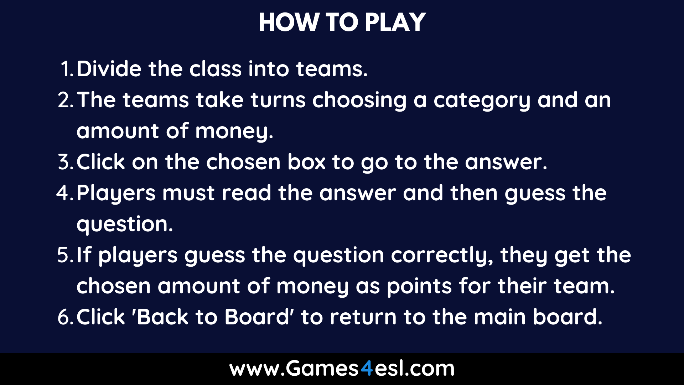

Slide 3

Category 1
Category 2
Category 3
Category 4
Category 5
Category 6
$200
$200
$200
$200
$200
$200
$400
$400
$400
$400
$400
$400
$600
$600
$600
$600
$600
$600
$800
$800
$800
$800
$800
$800
$1000
$1000
$1000
$1000
$1000
$1000

Slide 4

Category 1: $200
Paragraph is a group of sentence that combine together to develop only one topic.
What is Paragraph?
Back To Board

Slide 5
Category 1: $400
Topic Sentence= Topic + Controlling idea
What is Topic Sentence?
Back To Board

Slide 6
Category 1: $600
Supporting Sentences is the sentences that support a topic sentence.
What is Supporting sentences?
Back To Board

Slide 7
Category 1: $800
Topic + controlling idea
Controlling idea + Topic
What are the 2 ways to write a topic sentence?
Back To Board

Slide 8
Category 1: $1000
1. Topic Sentence
2. Supporting Sentences
3. Concluding Sentences
What are the 3 parts of a paragraph?
Back To Board

Slide 9
Category 2: $200
There are 2 styles of topic sentence.
No, it cannot.
How many styles of topic sentence?
Can a paragraph discuss more than one topic?
Back To Board

Slide 10
Category 2: $400
Sentence is a group of word that expresses a complete thought.
What is sentence ?
Back To Board

Slide 11
Category 2: $600
SV
SSV
SVV
SSVV
What are the 4 simple sentence “formulas”?
Back To Board

Slide 12
Category 2: $800
Title
First line
Big letters
Comma
Unity
Do you know the format of writing a paragraph? What are they?
Back To Board

Slide 13
Category 2: $1000
The controlling idea is the main point or topic of the paragraph. It guides the ideas expressed in the paragraph and helps you keep to the point
What does the controlling idea do?
Back To Board

Slide 14
Category 3: $200
However, On the other hand,
In contrast,
Contrast
Back To Board

Slide 15
Category 3: $400
In addition, Moreover, Furthermore, Also, Equally important
And
Back To Board

Slide 16
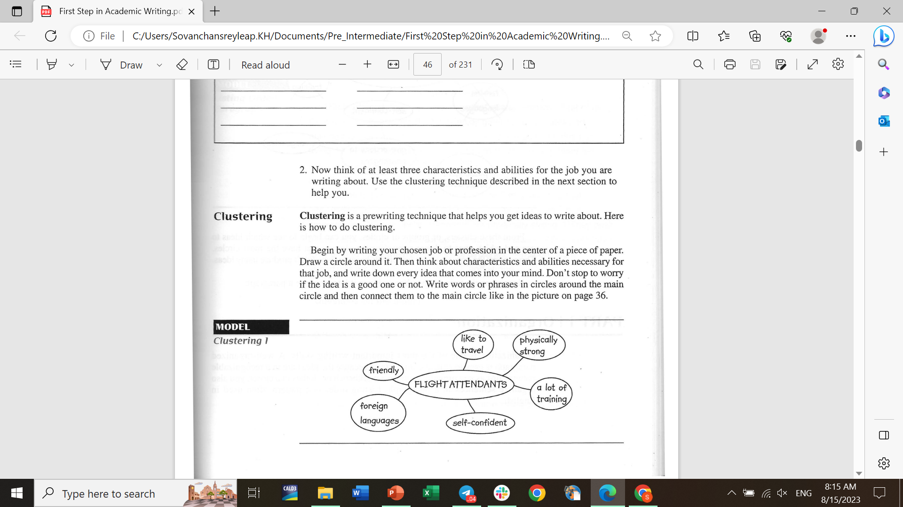
Category 3: $600
TYPE YOUR QUESTION HERE
What is clustering? How to do it?
Back To Board

Slide 17
Category 3: $800
Firstly, First of all, In the beginning
First
Back To Board

Slide 18
Category 3: $1000
Transition signal is a word or phrase that show how one idea is related to other idea.
What is transition signal ?
Back To Board

Slide 19
Category 4: $200
A young child who learns how to walk
What does it toddler?
Back To Board

Slide 20
Category 4: $400
Diet
Type your answer here and students should guess the question.
Back To Board

Slide 21
Category 4: $600
Lifespan
the length of time for which a person or animal lives or a thing functions
Back To Board

Slide 22
Category 4: $800
Genes
Something that people born with and it can protect them from disease.
Back To Board

Slide 23
Category 4: $1000
Expert
a person who is very knowledgeable about or skillful in a particular area
Back To Board

Slide 24
Category 5: $200
Proof
evidence or argument establishing a fact or the truth of a statement
Back To Board

Slide 25
Category 5: $400
3
If he go to school, he will be happy.
She speaks English if you will talk to her.
I will get mad if you talk to him.
Back To Board

Slide 26
Category 5: $600
1
She had had dinner.
She hads had dinner.
She have had dinner.
Back To Board

Slide 27
Category 5: $800
3
He have studied IT at PNC.
They have came from USA.
Dalis hasn’t talked with him.
Back To Board

Slide 28
Category 5: $1000
2
He doesn’t come to school if I won’t come.
If you listen to me, everything will be okay.
3. He did not work hard if you still complain.
Back To Board

Slide 29
Category 6: $200
3
1. If Him doesn’t speak to me I won’t be sad.
2. If HikHik talk to him, he will be happy.
3. He will miss the class if he gets up at 9AM.
Back To Board

Slide 30
Category 6: $400
1
Would you like a little milk?
Would you like a few milk?
Would you like many milk?
Back To Board

Slide 31
Category 6: $600
1
I have a lot of friends.
She has lot of boyfriends.
You have a lots of close friends
Back To Board

Slide 32
Category 6: $800
TYPE YOUR QUESTION HERE
What do you like and dislike ?
Back To Board

Slide 33
Category 6: $1000
2
Had He eaten breakfast?
Have you done your homework?
Had they gone to school.
Back To Board

